Slide 1

ME-609 Optimization Methods in Engineering
Presented by
Akash Kumar, 236103003(Machine Design)
Sumanta Das, 234103440 (Machine Design)

Slide 2
Project_ Phase 3 Multivariable Constrained Optimization using BRACKET-OPERATOR PENALTY METHOD
Methods used -
1.Bounding phase and Interval Halving for Unidirectional Search.
2.Conjugate Gradient method for Unconstrained Optimization.
3.Bracket-operator penalty method for Constrained Optimization

Slide 3
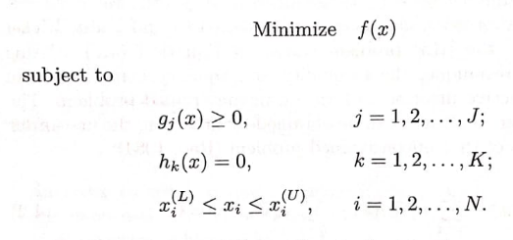
Multivariable Constrained Optimization
Constrained multivariable optimization concept are used in engineering design and decision-making problems.
Using this method convex or concave, linear or non-linear can be tackled.
Where
j = number of inequality constrains
k = number of equality constrains.
I = number of bound constrains

Slide 4
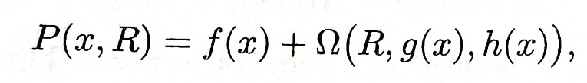
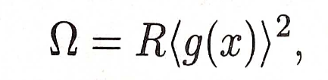
Bracket-operator Penalty Method -
We used penalty based constrained optimization. In which we used bracket operator penalty which is an exterior penalty term. The first sequence begins with small value of penalty parameter(R). We initialized R value as 0.1 and increase by a factor of (c = 10) in each sequence.
Penalty function (P) and penalty term (ohm) are given below.
<a> = a, when a is negative; and 0 otherwise.
Description of the Method-
For solving the problem penalty function method involves the following steps:
We transformed the original constrained optimization problem into an unconstrained optimization problem by combining the objective function with the penalty terms(ohm).
The included penalty terms penalizes the penalty function on violations of the constraints. The penalty terms are typically functions that increase rapidly as the constraints are violated.
Then we starts with initial guess vector. We starts the sequence in which we use conjugate gradient method for minimization of penalty function (pen_function).
The optimum vector got from conjugate gradient method is used as initial guess in next sequence.
The sequences are performed until the magnitude of penalty difference between two consecutive sequence is not achieved below the terminating condition(epsilonp2)

Slide 5
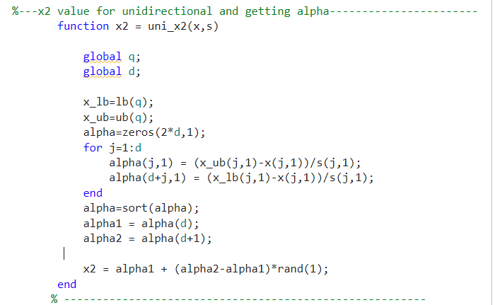
Flow chart for main function

Slide 6
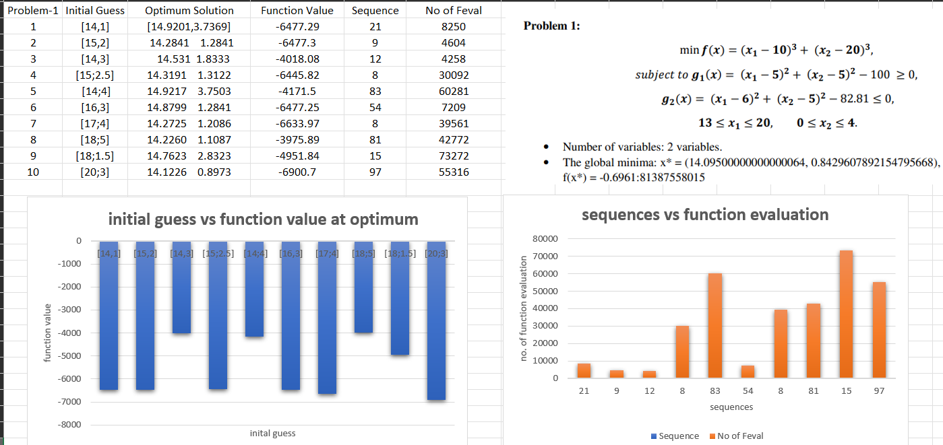




Problem 1

Slide 7
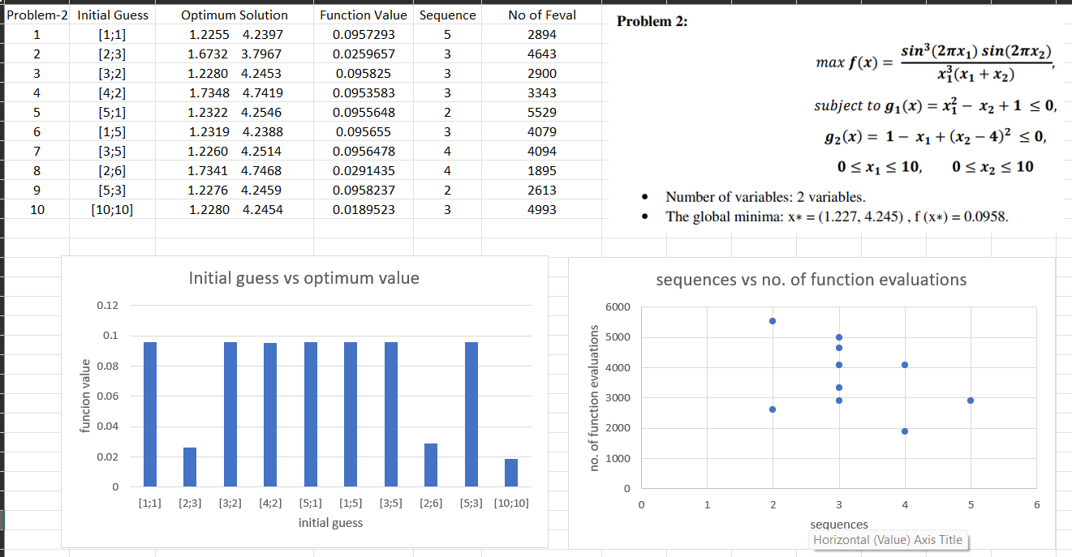


Problem 2

Slide 8
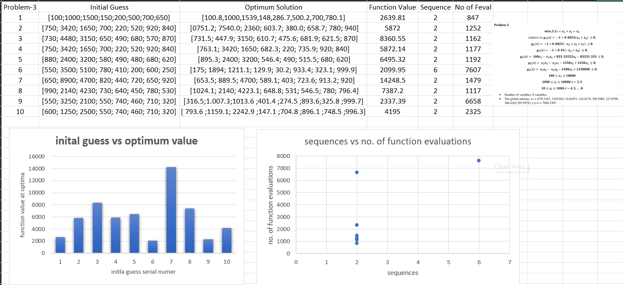


Problem 3

Slide 9
Result and Discussions:
Best and worst points are highlighted in the solution table with green and red color respectively.
Sometimes the algorithm is converging far from global minima that might happen due to convergence on local minima point.
Sometimes conjugate gradient method takes maximum iteration (k=M). In such situation the algorithm may or may not converge at correct point. In such condition number of function evaluation are huge.
We are taking initial guess(x2) for bounding phase in such a manner that the “x_new” vector always remains within the bound. For this purpose, we are generating random value for x2 within a certain range. Sometimes the algorithm stuck in ‘setting initial parameter again’ because of not minimizing function in any of two direction. But if we run the whole algorithm with same initial guess (xp0) the error would not appear due to the randomly generating number may generate a good x2 value.

Slide 10


